Slide 1
GitHub & LinkedIn: Your Digital CV
How to stand out in the job market
By: Abdul Rehman

Slide 2



Introduction
Academics - Graduated in FAST, Lahore in 2023 - Taught at FAST, Lahore from 2023-2024. - Conducted Research in LUMS from 2024-2025. - Currently Teaching Fellow at LUMS.
Industry - Did Freelancing from 2021-2024 - Helped Start-Ups i.e. FASTDEV Labs, TEXAGON, RixtySoft etc

Slide 3
Agenda
Section 1: The 3 C’s → Competition, Companies, CV
Section 2: What is Experience?
Section 3: GitHub & LinkedIn Deep Dive
Closing Checklist + Q&A

Slide 4
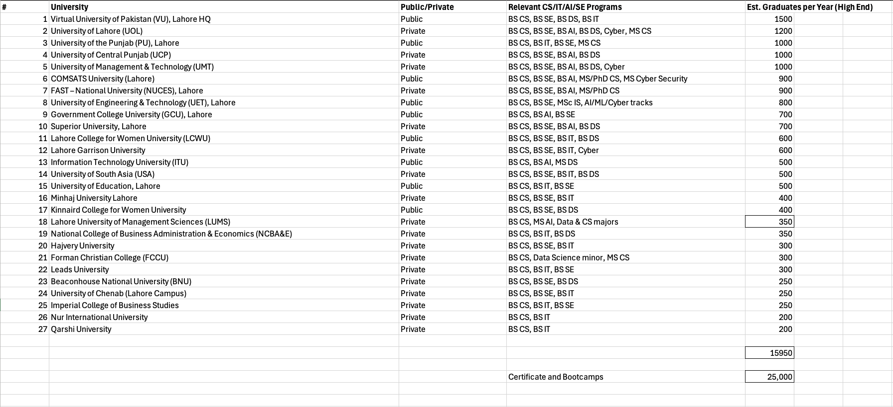
Competition
~16,000+ CS/IT grads every year in Lahore
Bootcamps, certificates, crash courses = more competition
Everyone is applying for the same junior roles

Slide 5
Competition
City | Estimated grads moving to Lahore/year
Karachi | 2,800
Faisalabad | 900
Hyderabad | 600
Sahiwal | 300
Islamabad | 1,800
Multan | 500
Rawalpindi | 1,000
Gujranwala | 400
Peshawar | 500
Quetta | 250

Slide 6
Competition
Category | Estimate (high-end/year)
Lahore CS degree holders | ~16,000
Other-city CS degree holders | ~9,000
Certificate / crash course entrants | ~25,000
Total Estimated Competition | ~50,000 CS/IT job seekers per year

Slide 7
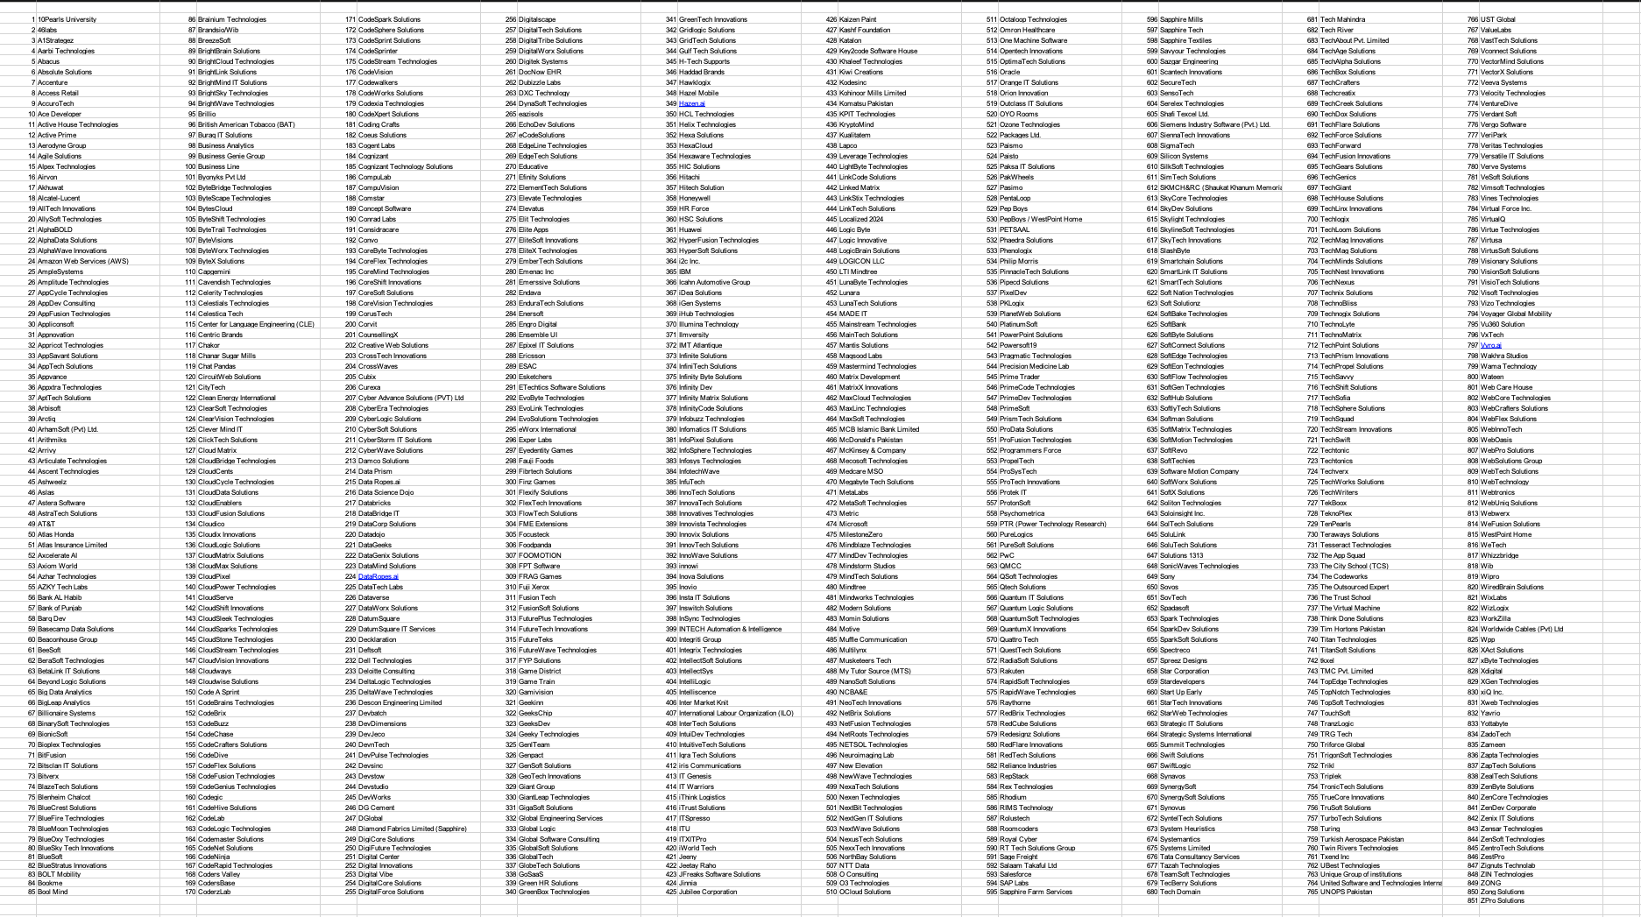
Companies

Slide 8
Companies
Around ~880 registered software houses in Lahore.
With Unregistered small firms, 3,000+ software houses in Lahore
New Positions open based on Company Growth
Limited junior openings per year
Job switchers further decrease Opportunities
Companies want proof of skill, not just degrees

Slide 9
CV
Hardcopy CV = First impression
Digital CV = LinkedIn + GitHub
Recruiters Google you before shortlisting
Profile Stacking

Slide 10
What is Experience?
Experience = What is written or What can be validated ?
“5 years in Python” means nothing without proof
In the ChatGPT era → validation matters more than ever

Slide 11
How Experience is Validated
GitHub → Code, commits, projects = proof
LinkedIn → Endorsements, recommendations, employer tags = proof
Freelancing Profiles
Portfolio/Website → Public track record

Slide 12
Imagine You are a Recruiter,
now you are looking at different Githubs profiles, who will you hire & why?

Slide 13
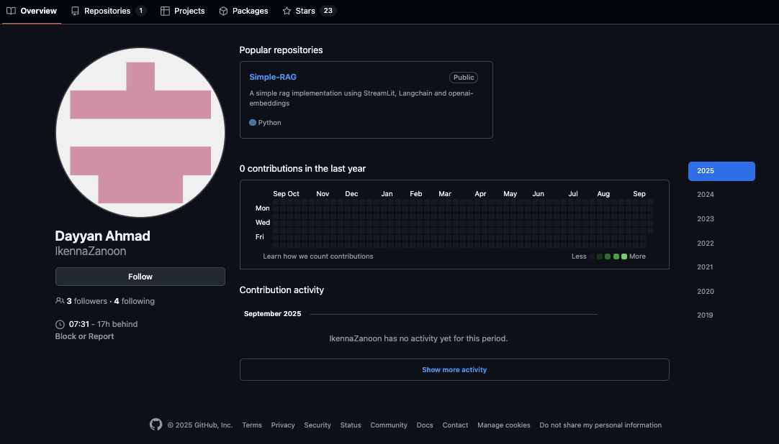
Case # 01:

Slide 14
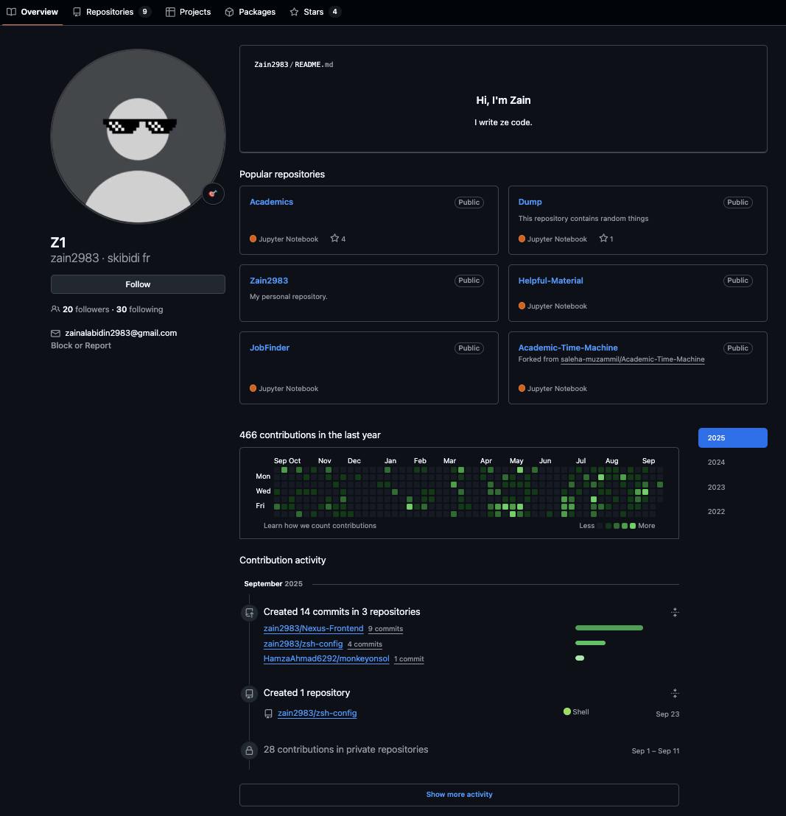
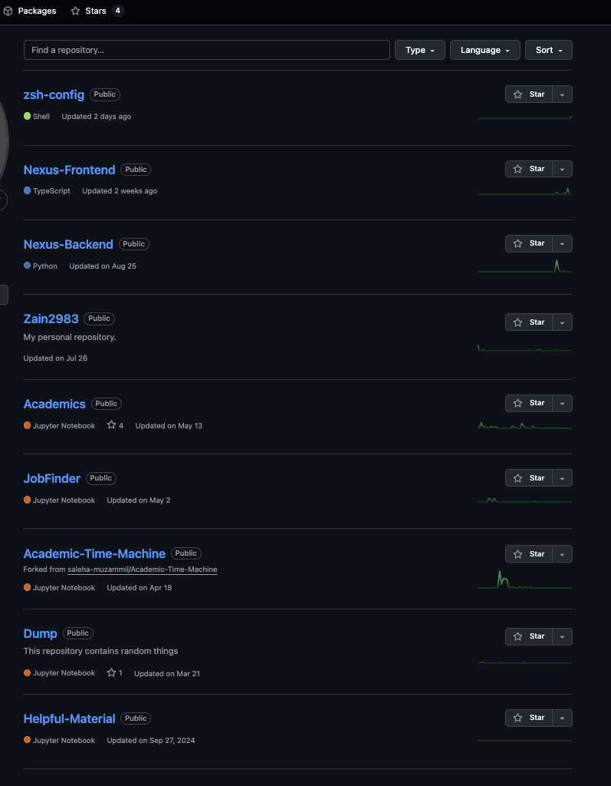
Case # 02:

Slide 15
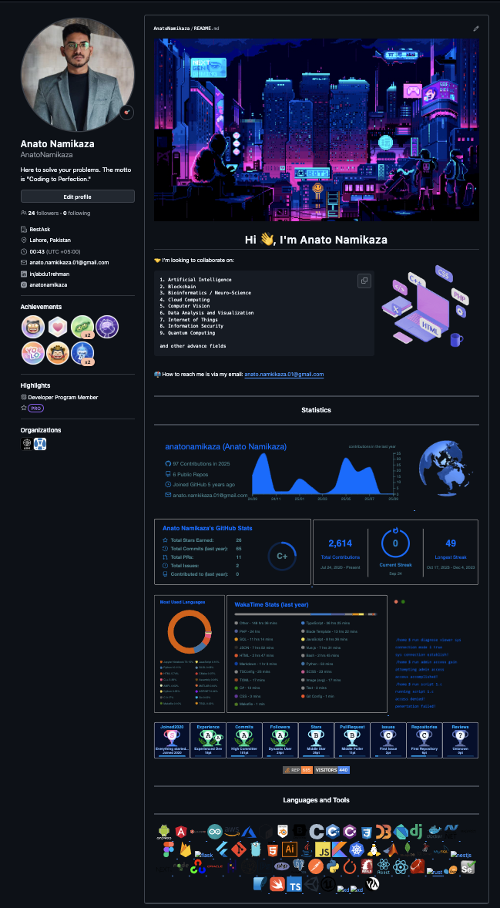
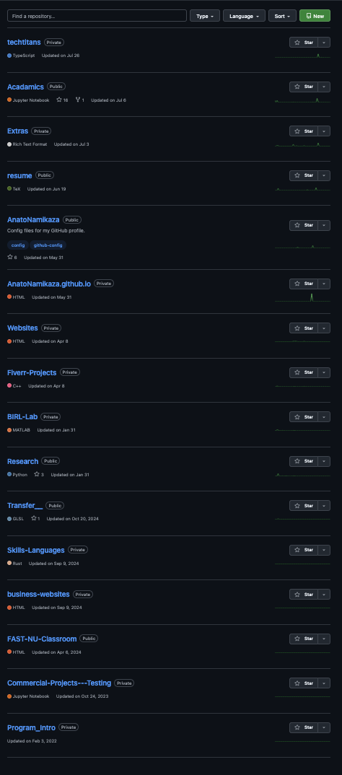
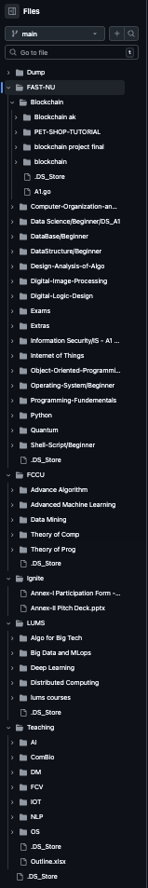
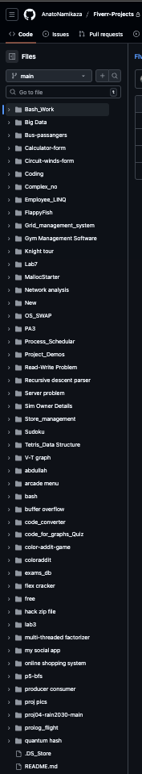
Case # 03:

Slide 16
GitHub: What Recruiters Look For
Profile README (your intro)
Pinned repos (top 5–6 projects)
Commit history (consistency > 100 repos)
Documentation (README.md, screenshots)

Slide 17
GitHub: How to Maintain
Clean repos (no final_final_v2)
Add README + usage instructions
Tech stack badges (Python, React, SQL, etc.)
Contribute to open-source if possible
Organizations Associated

Slide 18
LinkedIn: What Recruiters Look For
LinkedIn is a Booster for Extra Curricular and Soft Skills (i.e. Hackthon, Leadership, Networking etc)
Profile picture + banner = professional
Headline = more than 'CS Student'
About section = 4–5 lines pitch
Projects + skills + recommendations

Slide 19
LinkedIn: How to Maintain
Update regularly (skills, projects)
Post occasionally (project updates, coding tips)
Connect strategically (HRs, seniors, alumni)
Ask for recommendations

Slide 20
Good vs Bad Examples
Bad LinkedIn: No picture, empty About, just 'CS student'
Good LinkedIn: Professional picture, headline, projects, endorsements
Again, Consider yourself as a Recruiter, who will you choose?

Slide 21
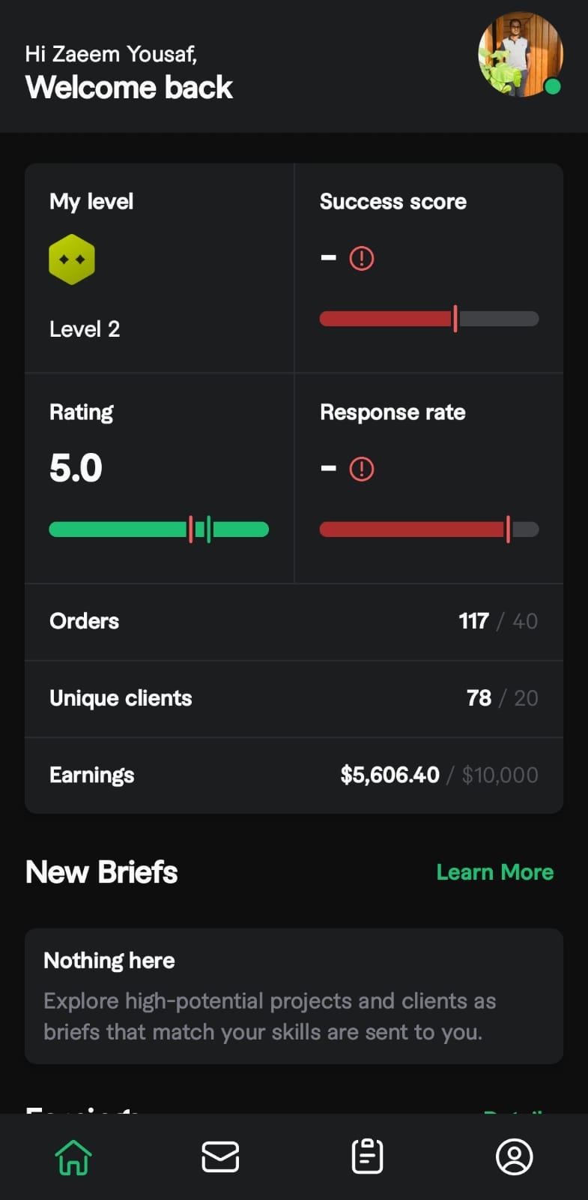
Is Freelancing a deal breaker?

Slide 22
Freelancing
Rather than what you said, its more about how you say it?
How do you use your Freelancing to your advantage?
How do you manage Company Expectations?

Slide 23
Checklist
Update LinkedIn headline & About
Add 3 polished repos to GitHub
Write README.md for each project
Ask 1 teacher/senior for LinkedIn recommendation
Stay active (2 posts/month, 2–3 commits/week)

Slide 24
Key Takeaway
Hardcopy CV gets you in the door
Digital CV (GitHub + LinkedIn) proves you deserve the job
Your skills are only as good as they are visible

Slide 25
Q&A
Any Questions?
GitHub: https://github.com/AnatoNamikaza
LinkedIn: in/abdu1rehman

